Slide 1
Multi Penalty Algorithm For Local Predator Prey Planning
BRIAN MATEJEVICH, CRISTIAN BUENO & KARAN SUTRADHAR

Slide 2
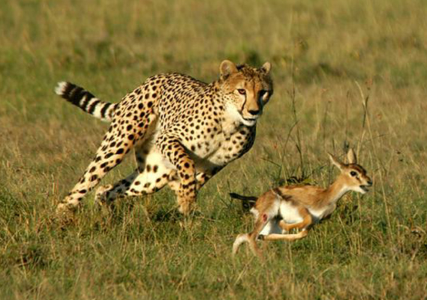
Introduction
Objective:
The goal of this project is to implement a simple and shallow path planner for the predator prey problem.
Method:
Path planning algorithm similar to A* and potential fields
https://kevinguvinnyvmaryamcgrasslands.weebly.com/predator-prey.html

Slide 3
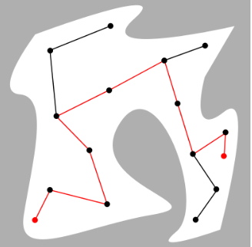
Assumptions
Small discretized map, 200x200. ( x-y plane)
Prey and Predator agents are point robots and move in a 2D space
Random start points
Distance - Manhattan
Time- Dependent f(x)
Agents have no dynamic constraints on movement.
https://commons.wikimedia.org/wiki/File:Motion_planning_configuration_space_road_map_path.svg

Slide 4
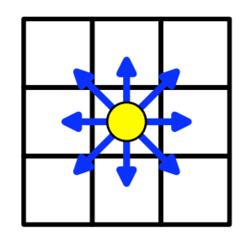
Action Space
The predator and the prey will use the same 8-action space.
Dynamic goal for the predator: prey can move anywhere.
Static goal for the prey: center point of map
Agents will make a short-term plan before each time-step, and will be aware of each others location.
http://ais.informatik.uni-freiburg.de/teaching/ss11/robotics/slides/18-robot-motion-planning.pdf

Slide 5
Predator
The predator’s goal is to “catch” the prey.
All nodes will have a “cost for predator” which will initialize as 255 and be replaced by 155 when visited by the prey.
Before each timestep the “cost for predator” will increase by 1 (capped at 255), thus giving preference to more recently visited nodes.
This will give a behavior like potential fields, yet adaptive to the movement of the prey.

Slide 6
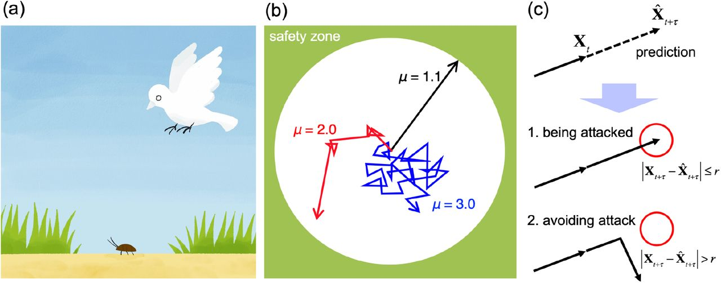
Prey
The prey’s goal is to avoid capture while minimizing distance to the center point.
All nodes will have a “cost for prey” which will start at 0 and be replaced with 100 when visited by the predator.
Again, “cost for prey” will be decreased by 1 each time step (with a floor of 0) to take preference to more recently visited nodes.
https://www.biorxiv.org/content/10.1101/2020.03.04.976076v1.full

Slide 7
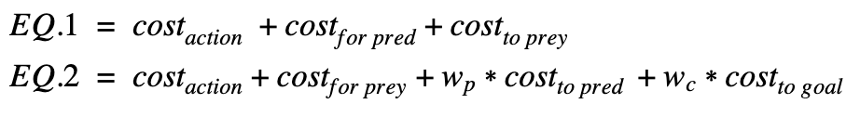
Algorithms
We used a simple heuristic cost function, including step cost, cost to prey and cost for pred for the predator’s path planning.
The prey used a similar style heuristic cost function but included, action cost, cost to pred, cost for prey and cost to center.
Wc and Wp are weights corresponding to the cost of predator proximity and distance from goal.
Note: Wp is negative

Slide 8
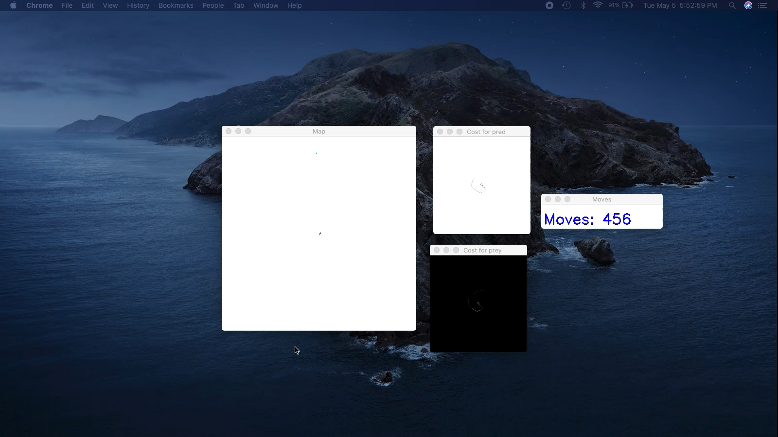

Slide 9


Slide 10
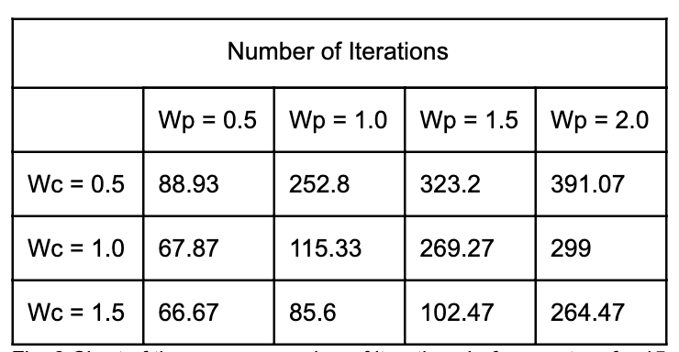
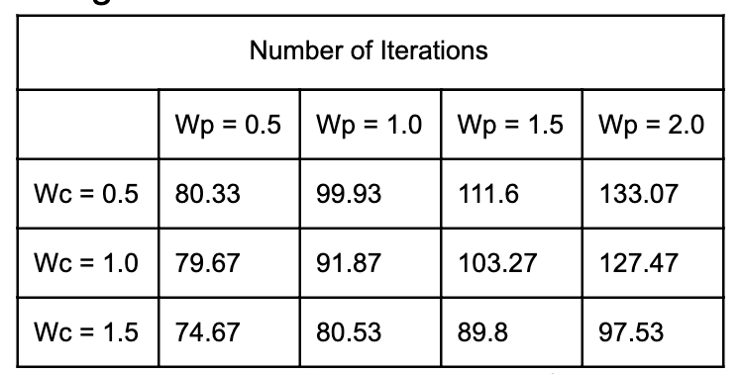
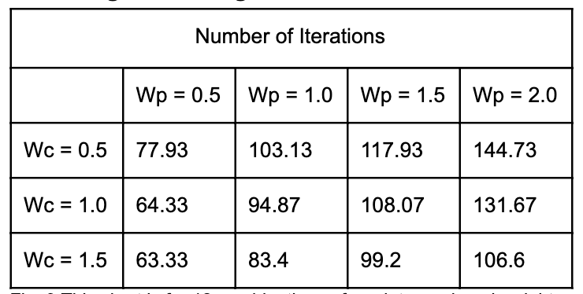
Results
Speeds:
Predator: 1
Prey: 1
Predator: 2
Prey: 1
Predator: 3
Prey: 1

Slide 11
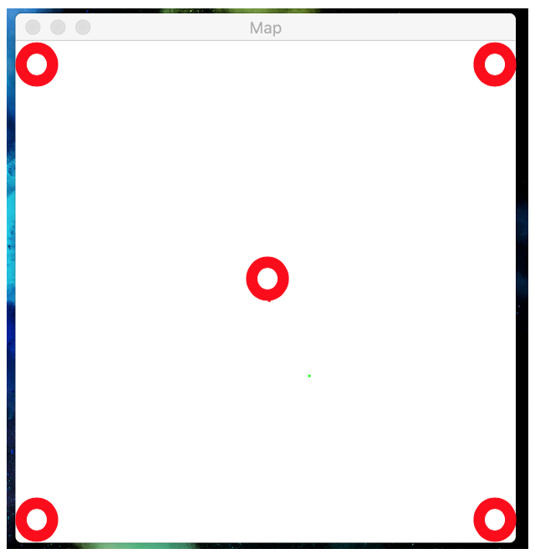
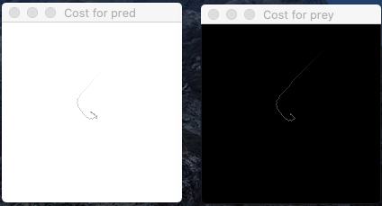
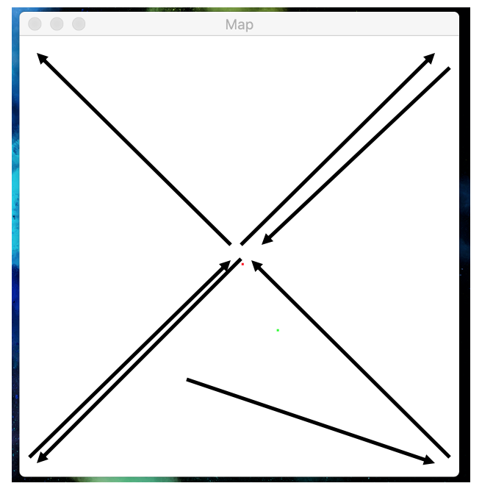
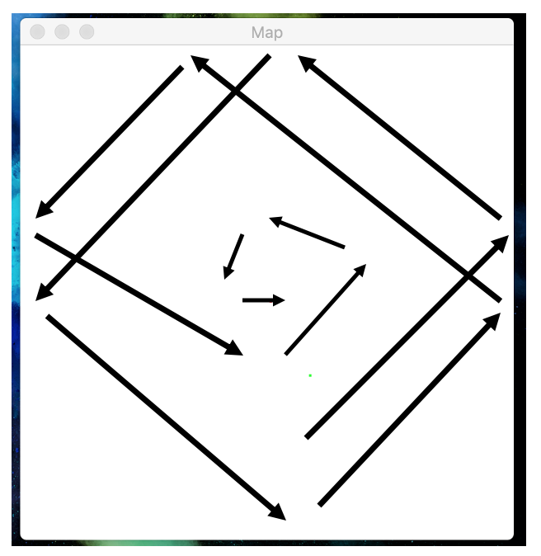
Emergent Behaviors

Slide 12
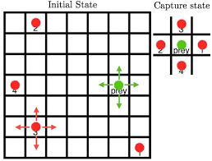
Future Work
Explore more weight combinations
Add obstacles to the map to see if patterns continue
Add multiped predators or goal locations
Estimate predator direction and implement it in prey cost function
“Coordinated Multi-Agent Imitation Learning “ http://proceedings.mlr.press/v70/le17a/le17a.pdf

